Slide 1
MERN stream Project simulation

Slide 2
Introduction
This project simulation is required to be completed as part of MERN Stream.
The objective of this course is to provide hands-on experience for the participants on the skills learnt during the course.
This will be an individual activity.
The duration of this project simulation part will be 5 days.

Slide 3


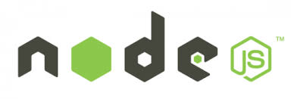


Technical skills : MERN stack
R
NoSQL Database
Web application server framework
Front-end Library for SPA
Server-side JavaScript environment
CSS framework for responsive design

Slide 4
Software requirements
IDE : VS Code
NodeJS
MongoDB

Slide 5

Overview
Pizzeria is a app where users book pizza online.
The users choose from the existing menu and order pizzas.
The users can also customize their pizza by choosing ingredients.

Slide 6
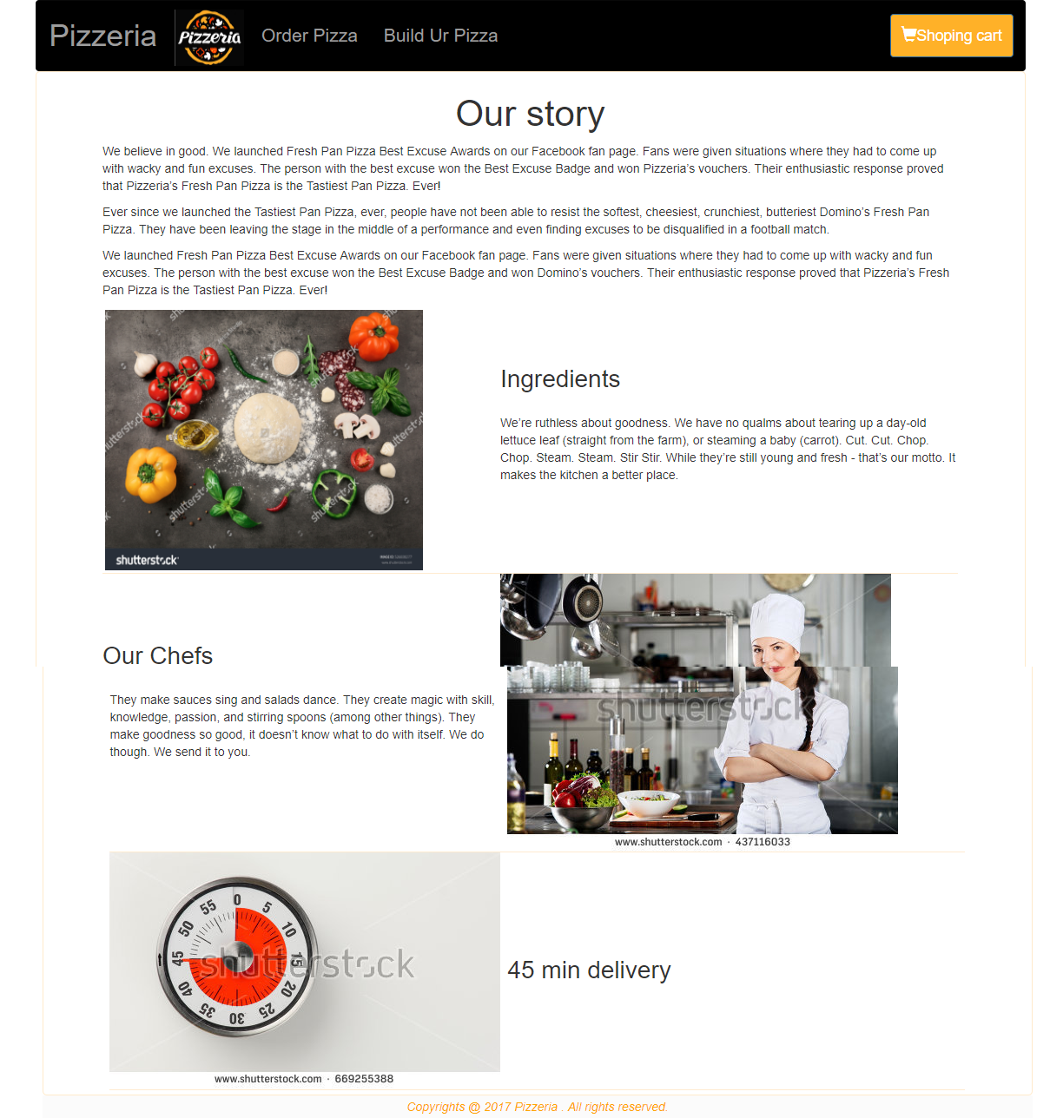
User Story 1 : Home Screen
The Pizzeria home page provides an overview of the organization.
The user should be able to navigate back to the home page by clicking on the logo.
The functionality for the Shopping part screen is planned for next release.

Slide 7
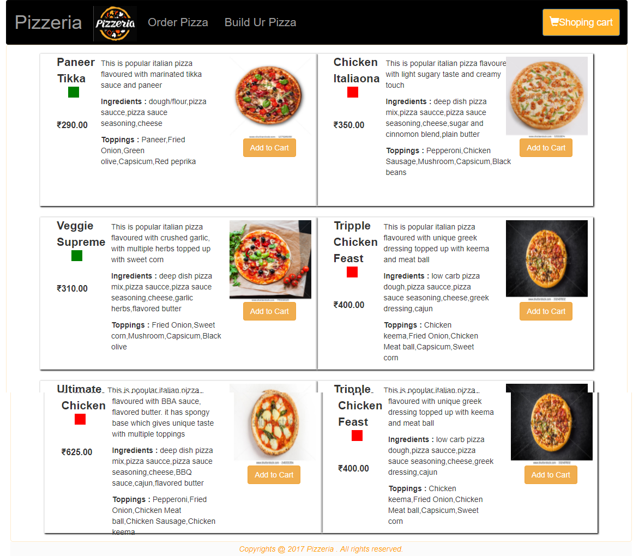
User Story 2 : Order Pizza
User should be able to place order from existing menu
The data for this screen should be fetched from the MongoDB database.
The ‘Add Cart’ functionality is planned to be implemented in the next release.

Slide 8
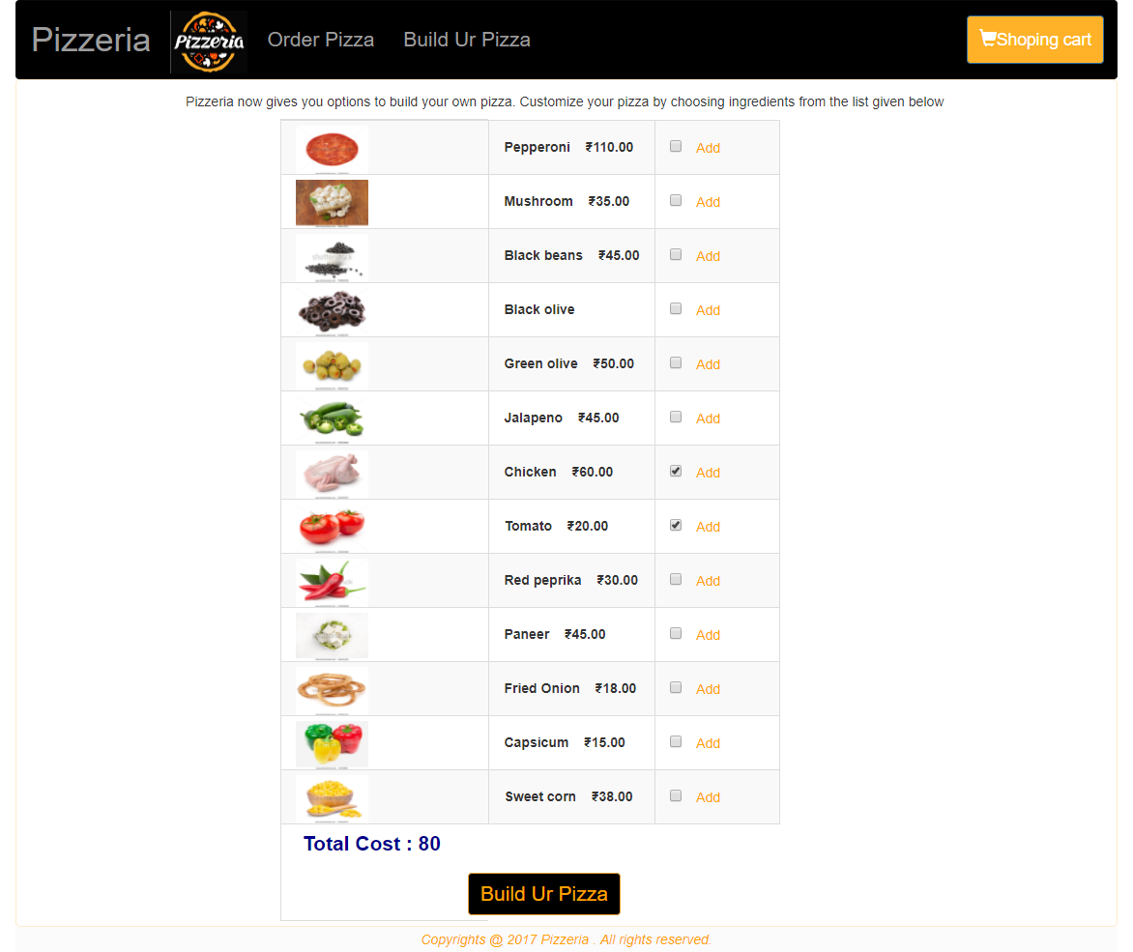
User Story 3 : Build Ur Pizza
User should be able to customize their pizza and place orders.
The ingredient details has to be fetched from the mongoDB database.
As the ingredients are selected the total cost should be displayed dynamically.

Slide 9
Deliverables
Demo of the Running application where by user is able to order pizza.
Validations should be properly implemented in the UI
Code should follow the code standards as per guidelines
No warnings or errors for the Linting (JSHint, TSLint)

Slide 10
Notes:
Faculty Notes:
Ask participants if they have any questions from the lesson.
Participant Notes: N/A

